Slide 1
Weekly report

Slide 2
Processes can be accelerated with VA API
Motion compensation (mocomp)
Inverse discrete cosine transform (iDCT)
In-loop deblocking filter
Intra-frame prediction
Variable-Length Decoding (VLD)
Bitstream processing (CAVLC/CABAC)

Slide 3

In-loop deblocking filter
Using deblocking filter to make image smooth

Slide 4
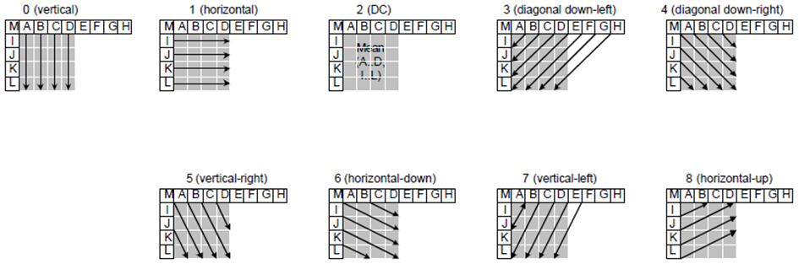
Intra-frame prediction
Intra 預測模式利用周圍像素資訊，能有效消除畫面內冗餘性。

Slide 5
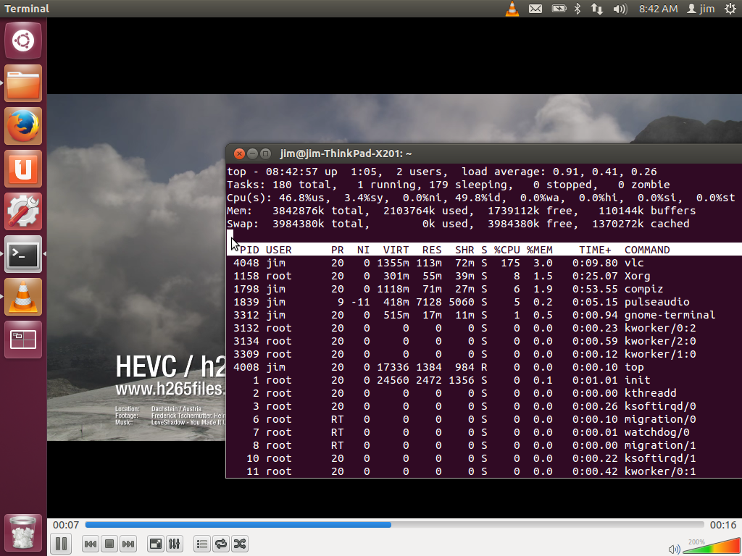
Libva un support Hevc

Slide 6
